Slide 1


What does high quality work look like?
F e b r u a r y 2 0 2 3

Slide 2
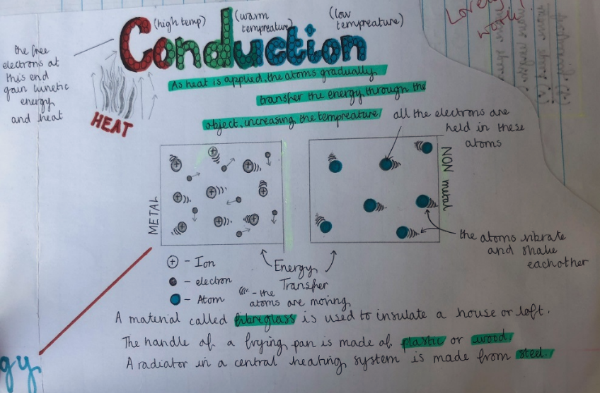

Students should take PRIDE in their work
Your books are the product of your learning

Slide 3
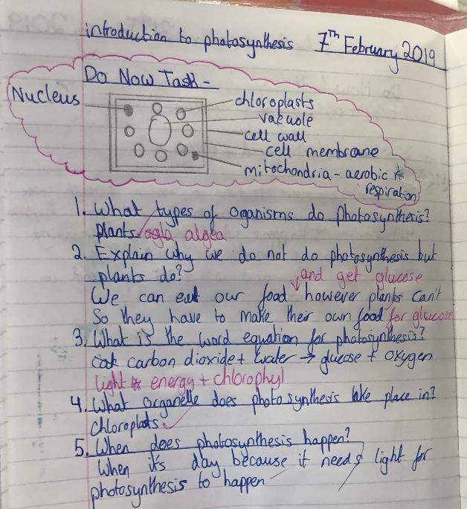
Write in blue or black
Write the date
Underline with a ruler
Write the title
Glue in all sheets
Draw diagrams, graphs and tables in pencil
Notes:
3

Slide 4
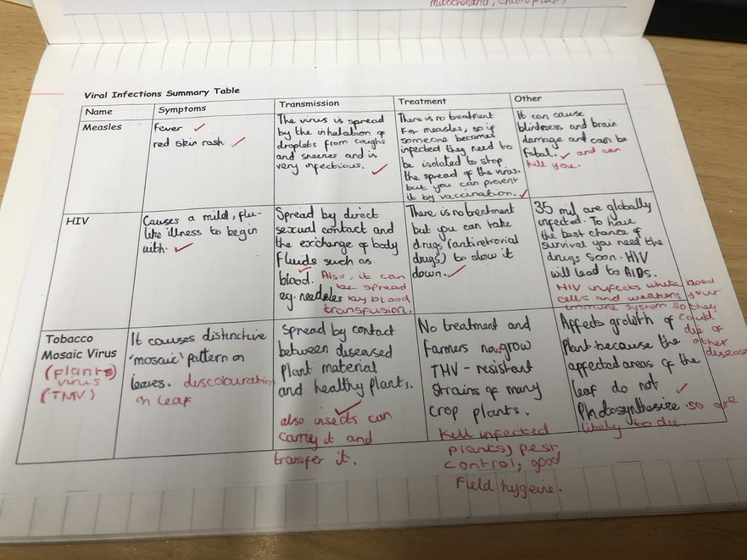
Make sure all tasks are completed
And give detailed answers
Notes:
C Goodwin

Slide 5
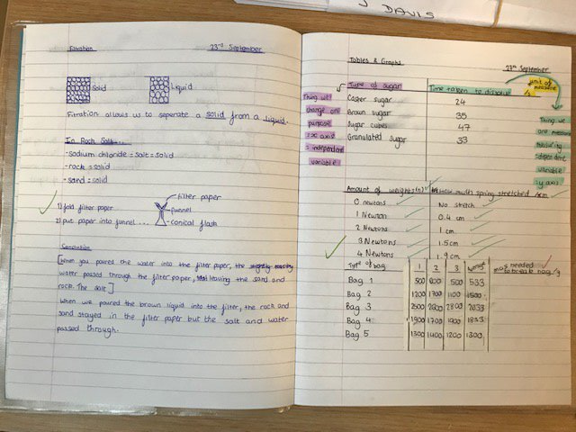
Mark your own work
Use a different coloured pen
Notes:
C Grimes - Good

Slide 6
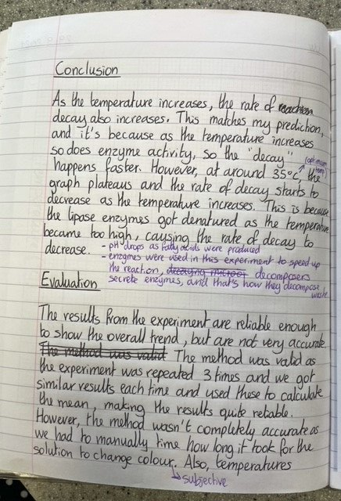
Make corrections
Make improvements
Respond to feedback
Notes:
T Cornwall - Y11 Good examples

Slide 7
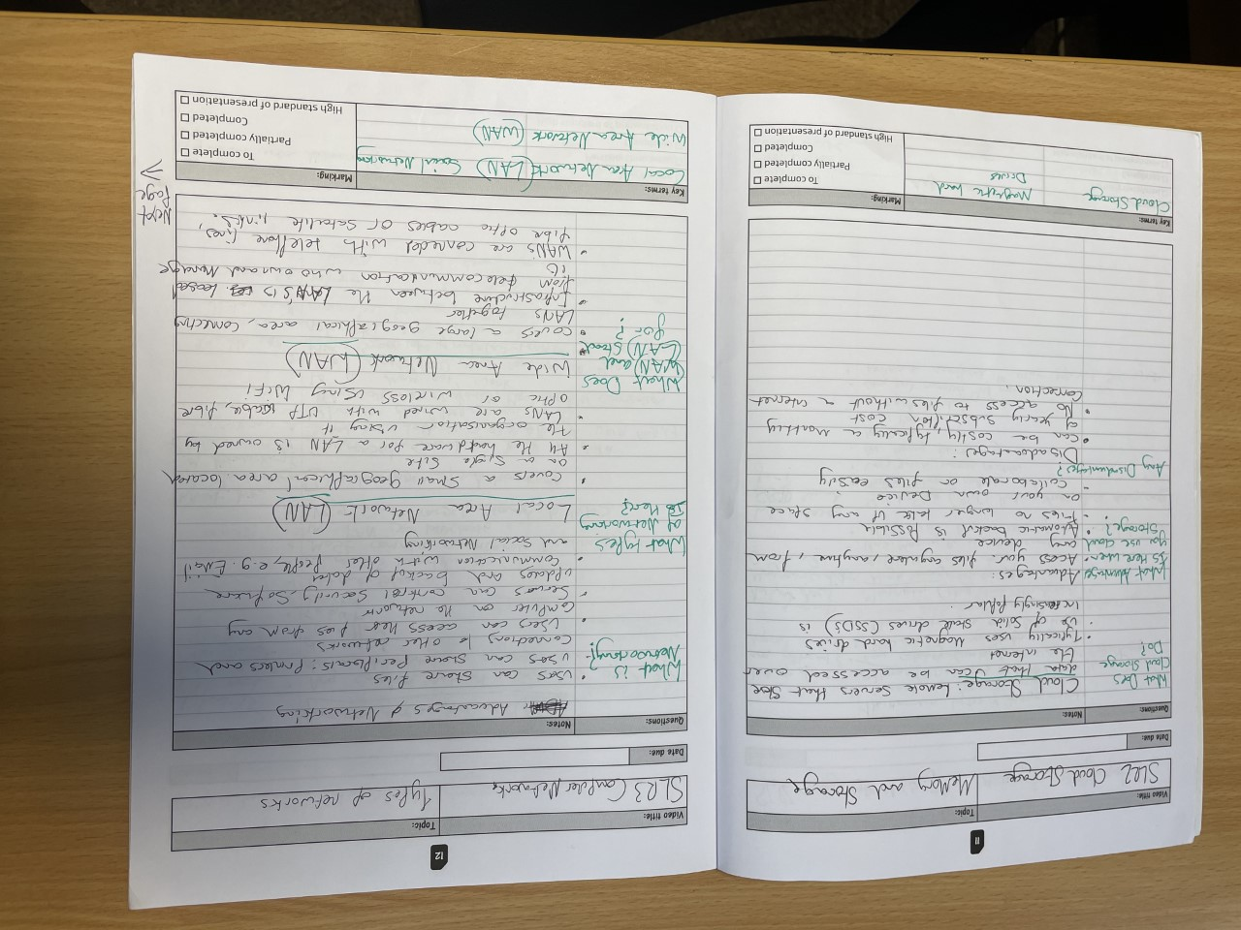
Think about the layout of your notes
And use the space on the page

Slide 8
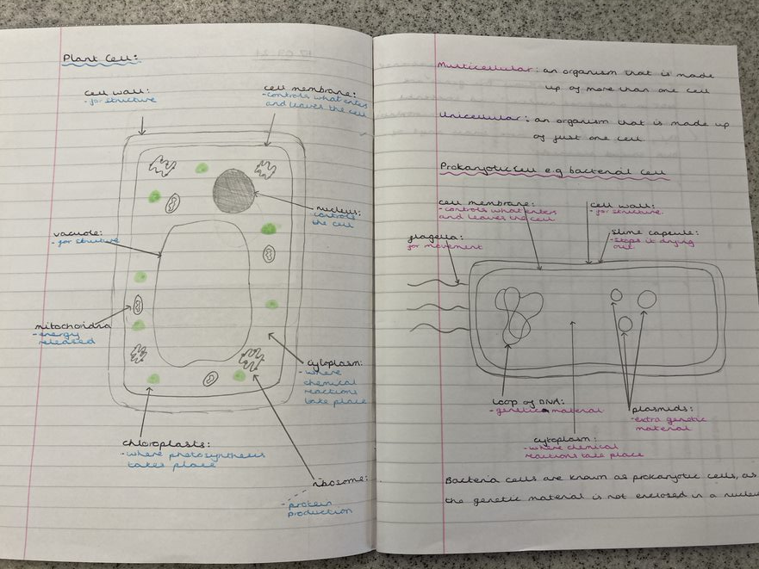
Use diagrams to support your written notes
Label diagrams
Notes:
K Whittaker

Slide 9
Use highlighters to make key words and definitions “POP”

Slide 10
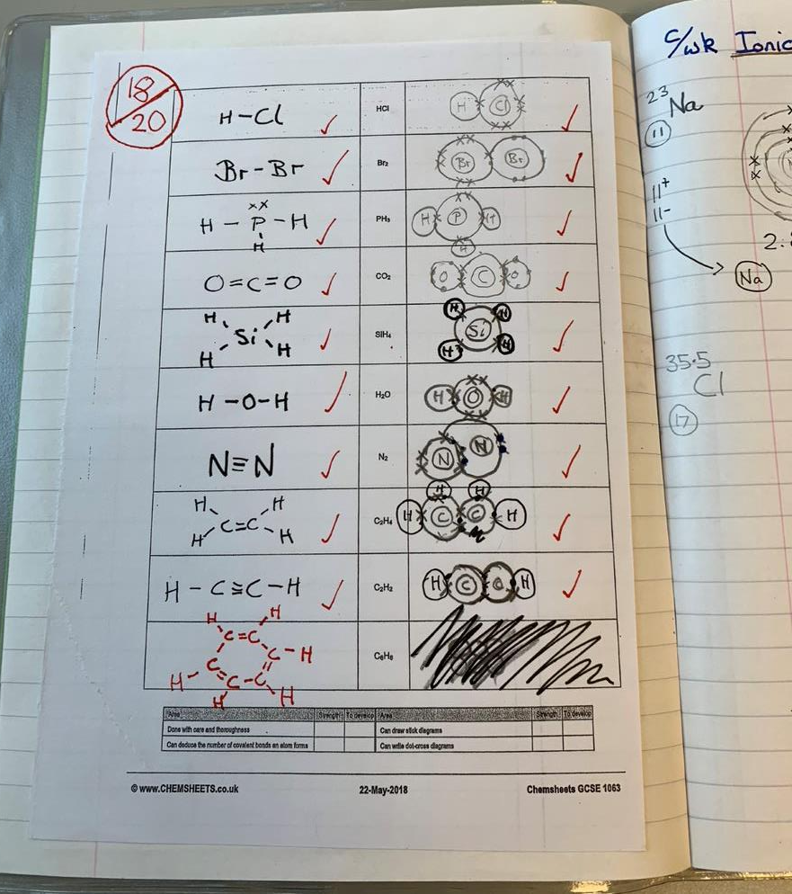
But don’t be afraid to make mistakes!!
They can be a sign of challenge and thinking hard.

