Slide 1

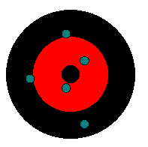
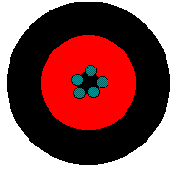
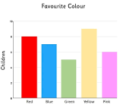
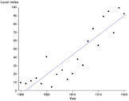

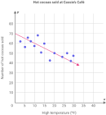
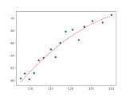
KS3 Disciplinary Knowledge
Precise but not accurate
1. | Practical steps
Prediction | What you think will happen and why (use theory)
Apparatus | The equipment you are going to use
Method | The steps you are going to take in the experiment. They should be given in enough detail for somebody else to be able to follow them
Results | What you have found out. These should be recorded as you do the practical, not afterwards
Conclusion | What your results tell you. What is the relationship between your independent and dependent variables?
Evaluation | Were there any problems with the experiment? Can you suggest any improvements?
2. | Variables
Independent Variable | The thing you CHANGE in an investigation
Dependent Variable | The thing you MEASURE in an investigation
Control Variable | The conditions you KEEP THE SAME in an investigation so that they don’t affect your results
Categoric variable | Have names that are labels such as eye colour
Continuous variables | Are values or numbers. Can be plotted on a number line
3. | Data
True Value | The actual answer
Accurate | A result that is close to the true value
Precision | Results have very little spread around the mean value
Repeatable | The same person repeats the experiment and gets the same results
Reproducible | A different person repeats the same investigation and gets the same result
Neither precise nor accurate
Precise and accurate
4. | Graphs
For categoric data | Display results using a bar graph |  | X axis – Your independent variable Y axis – Your dependent variable Label each axis
For continuous data | Display results as a scatter graph with a line of best fit to show the trend |  | X axis – Independent variable Y axis - Dependent variable DON’T forget units Both axes should be written as an evenly spaced number line
Line of best fit | A smooth line which can be straight (using a ruler) or a curve |  | Plot all points with a pencil. The line of best fit should also be in pencil.

